Slide 1
Xbox Game recommendation system - Implementation & Analysis
Advisor: Prof. Wencen Wu
Team #4
Team Members:
Animesh Grover (012564760)
Kashika Jain (012505649)
Vishwanath Patil (012526410)
Watcharit Maharutainont (012483614)

Slide 2

Introduction
The objective of the project is to build a predictive model to expose an item to the users based on their interests and the historical games searched
Prediction is based on the items searched and clicked by the user. The model is trained based on the category of the item(Xbox games) the user is interested in
Based on this information, new and trending games that matches the user interests is recommended to the user

Slide 3
Dataset Details
The dataset contains 42.2k records for training and 28.2k records for testing.
We have details about
user: A user ID
sku: The stock-keeping unit (item) that the user clicked on
category: The category of sku
query: The search terms that the user entered
click_time: Time the sku was clicked on
query_time: Time the query was run
Source:
https://www.kaggle.com/c/acm-sf-chapter-hackathon-small/data

Slide 4
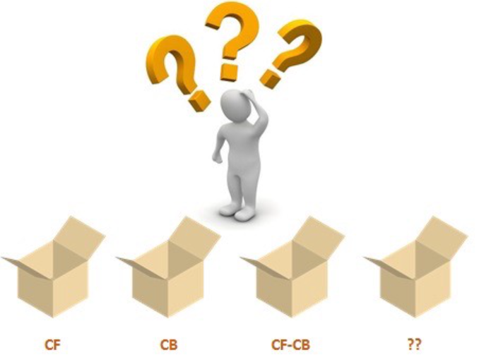
Recommender System
Two most common types of recommender systems are Content-Based and Collaborative Filtering (CF).
Collaborative filtering produces recommendations based on the knowledge of users’ attitude to items, that is it uses the "wisdom of the crowd" to recommend items.
Content-based recommender systems focus on the attributes of the items and give you recommendations based on the similarity between them.
Collaborative Filtering
In general, Collaborative filtering (CF) is more commonly used than content-based systems because it usually gives better results and is relatively easy to understand .
The algorithm has the ability to do feature learning on its own, which means that it can start to learn for itself what features to use.

Slide 5
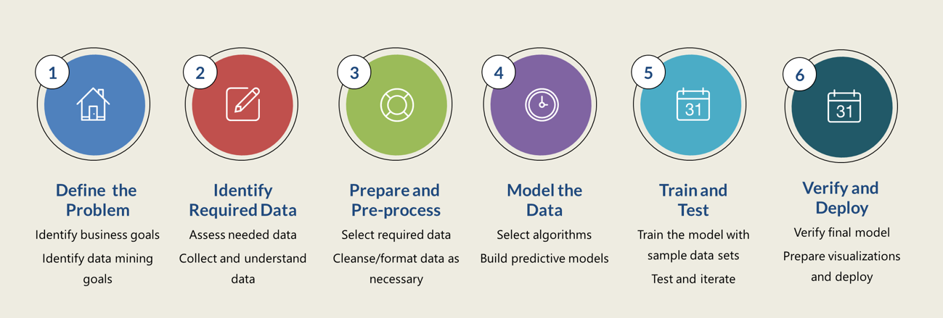
Project Phases
★Requirement Analysis
★Data Exploration
★Data Preprocessing
★Model Building
★Evaluation
★Model Deployment

Slide 6
Algorithm Implementation
We have built the following models for Xbox recommendation system-
Recommendation using SVM
Recommendation using Kmeans
Programmatic Approach
Comparison with the already existing approaches

Slide 7
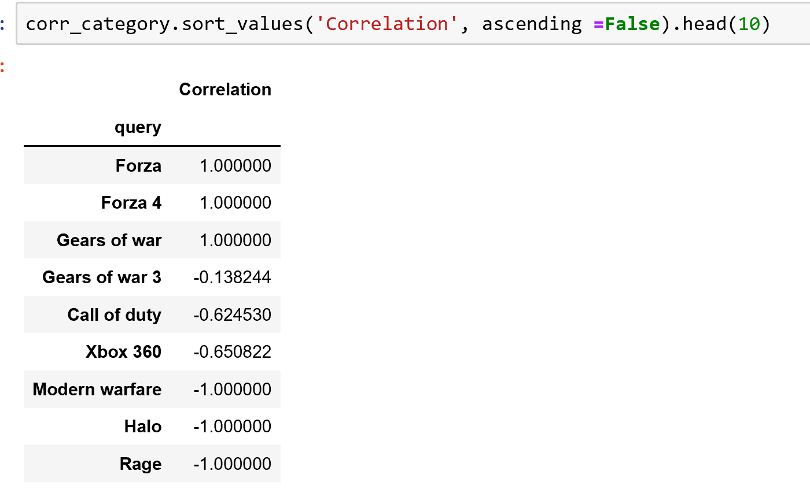
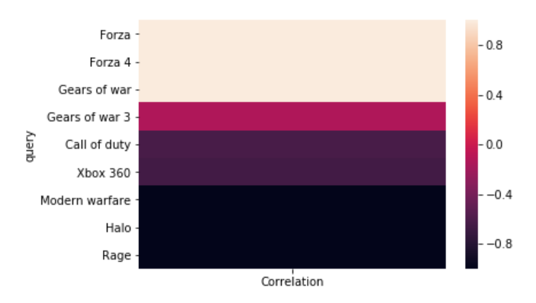
Exploratory Data Analysis
We performed some exploratory data analysis to understand the dataset better and to determine correlations between the users and the games
In this example we have found games that are similar to the game “Gears of War”
The correlation between games is useful in recommending similar games to users
Similarity between users is calculated using “pairwise distances” using cosine similarity

Slide 8
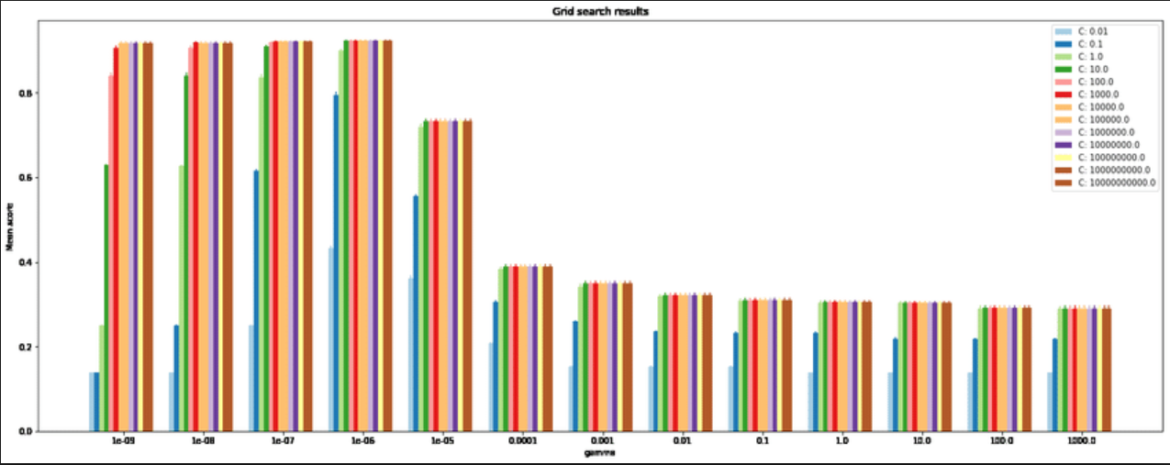
Algorithm used - Support Vector Machines
In recommendation systems, we use SVM. The algorithm repeatedly corrects the missing values in the user-item matrix.
GridSearch algorithm is used to improve the prediction accuracy
Finding the right parameters (like what C or gamma values to use) is a tricky task!

Slide 9
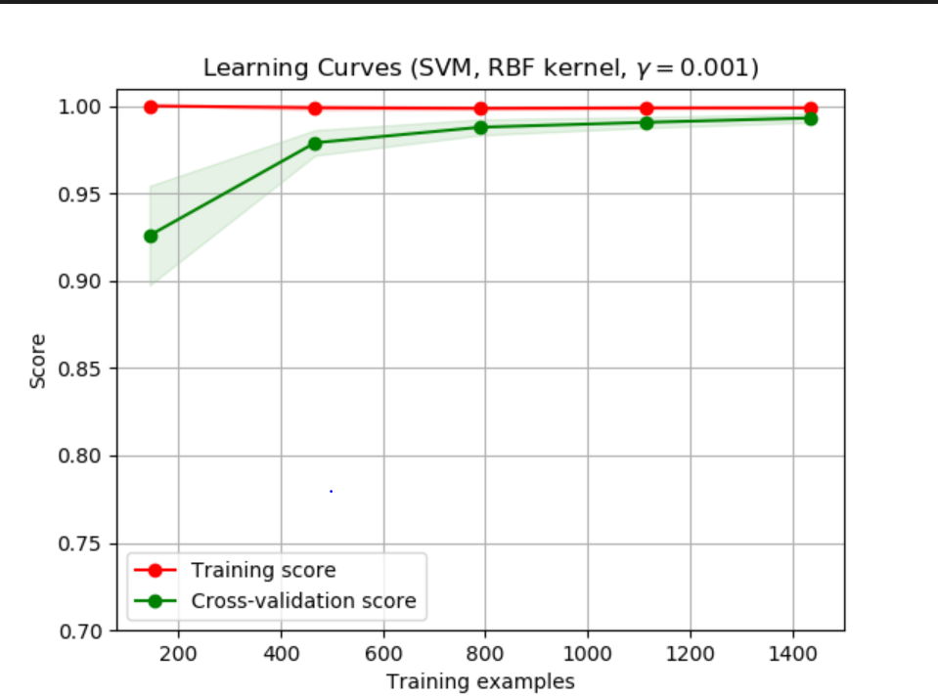
Algorithm used - Support Vector Machines
This idea of creating a 'grid' of parameters and just trying out all the possible combinations is called a GridsearchCV.
The CV stands for cross-validation which is the GridSearchCV takes a dictionary that describes the parameters that should be tried and a model to train. The grid of parameters is defined as a dictionary, where the keys are the parameters and the values are the settings to be tested.
One of the great things about GridSearchCV is that it is a meta-estimator. It takes an estimator like SVC, and creates a new estimator, that behaves exactly the same - in this case, like a classifier.

Slide 10
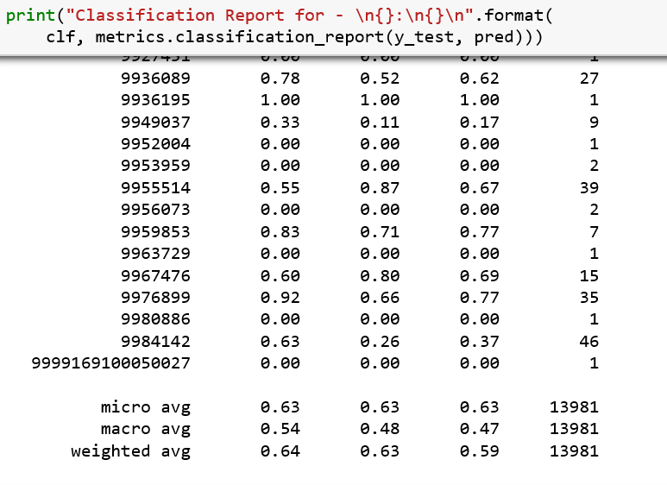
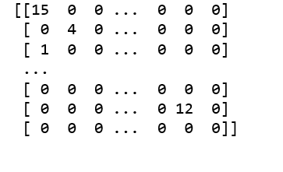
SVM Evaluation Metrics
Classification Report
The SKUs predicted for users using the SVM gives us
Precision - 64%,
Recall - 63% and
F1-score -59%
Confusion Matrix - gives the performance of a classification model on a set of test data for which the true values are known. It gives a table for comparison of True Positives with False Positives

Slide 11
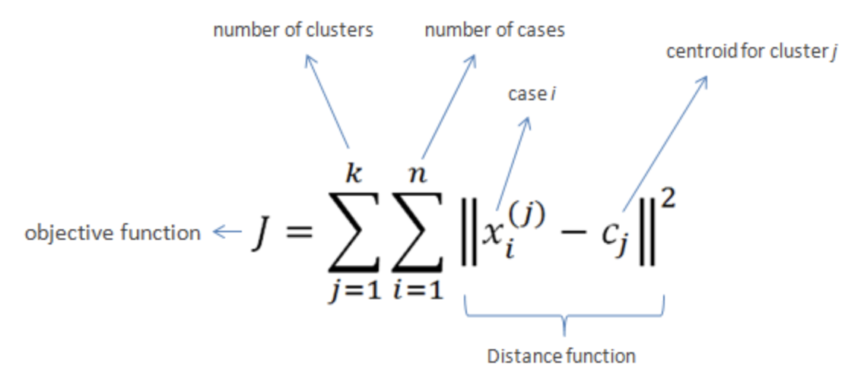
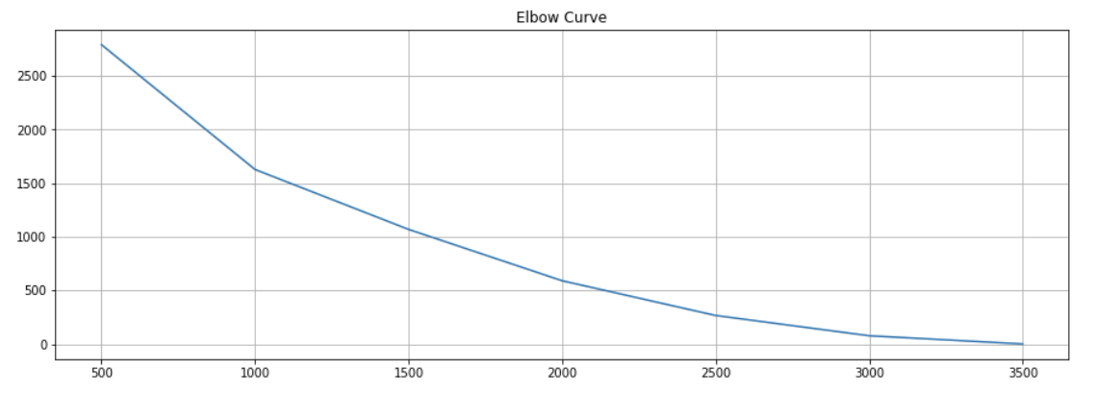
Algorithm used - k-means clustering
Partition n objects into k clusters in which each object belongs to the cluster with the nearest mean.
Calculate Euclidean distance of samples and centroids.
k can be selected based on Elbow curve graph (sum of squared distances to the nearest cluster center (inertia) against number of clusters).
Fast (O(n * K * I * d)), easy to use
Accuracy 64.4%

Slide 12

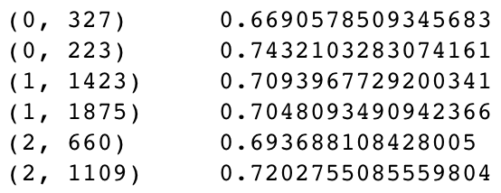
Algorithm used - tf-idf
Reflects how important a word is to a document in a collection or corpus.
Term Frequency (tf) - how frequently a word occurs in a document
Inverse Document Frequency (idf) decreases the weight for commonly used words and increases the weight for words that are not used very much in a collection of documents.

Slide 13
user sku category query click_time query_time
Dataset
Feature Selection
Dataset
Splitting
train
test
1
sku query
2
80%
20%
6
Data Preprocessing
Reducing
3
7
tokenize and vectorize
get the most selected sku for each cluster
train
test
sku query query vector
Cluster | sku
0 | 3046066
1 | 2340293
. | .
sku | Query | Cluster
2953607 | minecraft | 50
9854804 | battlefield | 1203
. | . | .
Query | Cluster | sku
minecraft | 50 | 2953607
. | . | .
4
Modeling
query vectors
query
vector
query
vector
Clustering
Output
5
8
Predicting
Model (n clusters)
use cluster as a key to get sku
Query | Cluster
minecraft | 50
. | .
9

Slide 14
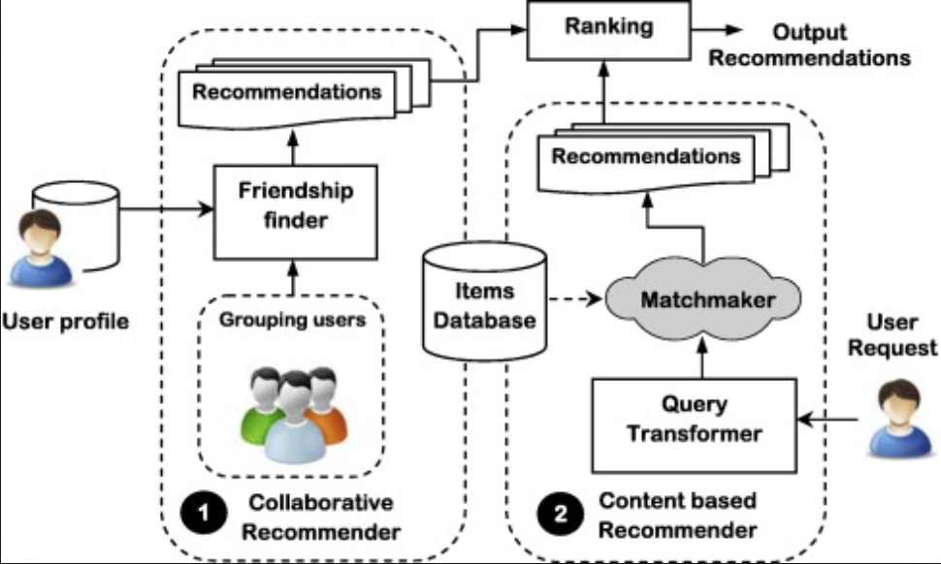
Programmatic Approach
The basic idea is try to match a query with a game ignoring all other features like time, game name etc.
The initial approach is to create a mapping between the user's input query and the Sku of the games which means that we store which game the user clicked and the frequency of it when user searches for this query.
Useful data fetched from the raw data is stored in dictionaries.

Slide 15
Programmatic Approach
When predicting the Sku’s for the input queries we simply choose the most frequently clicked games for this query.
If there are less than 5 games, we use the most popular games among all queries to fill the gap.
One optimization we used here is to correct users' queries. Since there are lots of typos or short forms, we use Levenshtein library to calculate two queries similarity, and if it is above a threshold, the algorithm believe they are the same query.
The threshold is chosen by testing on cross validation set.

Slide 16
Programmatic Approach
Finally using this approach we were able to get a prediction accuracy of 87 percent for 2000 data elements.
But using the same approach for the entire dataset the accuracy drastically dropped to 42 percent.
Hence we can infer that, using this technique is not a very good idea to predict the sku’s for the input user queries.

Slide 17
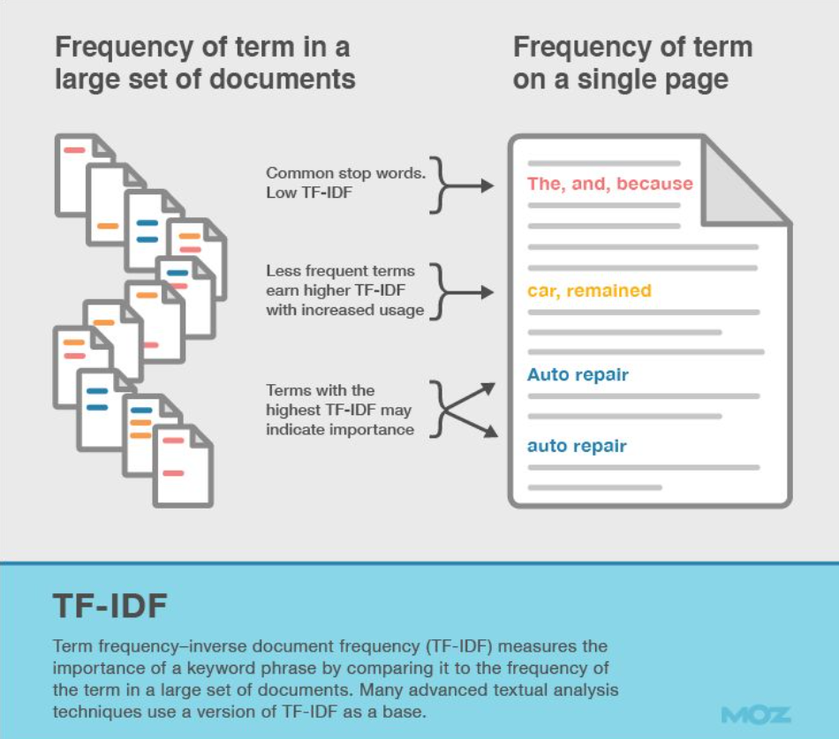
Data preprocessing / Algorithm variations
Most relevant features required were not available in this dataset.
Metadata about products was available in a large excel file.
TF-IDF algorithm for queries vectorization

Slide 18
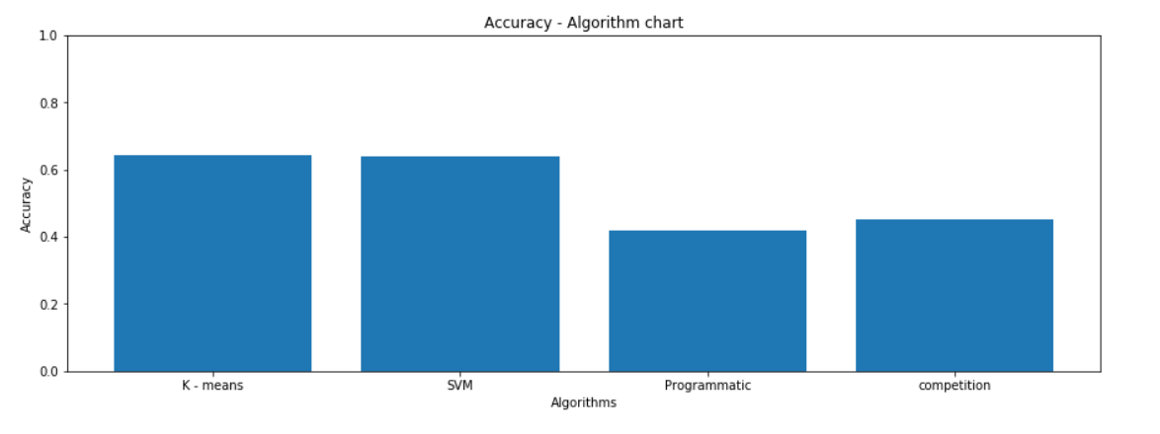
Evaluation of Implemented Algorithms
The models developed by us gave a much better prediction than the ones developed in the competition
The algorithms used in the competition were not were not based on machine learning

Slide 19
Things that worked
Challenges faced
Few top performing teams methodology in the competition was explained.
Dataset was large enough and had mostly labeled data
Not many useful features were available.
Most of the meta data for each product was in a separate excel file
Our machines took very long time to train and run for each algorithm
Conclusion
K-means was the best performing algorithm for this kind of dataset and recommendation.

Slide 20
Work Distribution
Animesh Grover :
Worked on and understood algorithms used for the competition, worked on programmatic and hybrid approach, evaluating different models accuracy
Kashika Jain :
Performed Exploratory data analysis and Implemented SVM algorithm to work with this dataset to yield better results, fine tuned the algorithm to get reasonable accuracy in short amount of time.
Watcharit Maharutainont :
Came up with an approach as well as implemented program to solve the problem, from data preprocessing through prediction.
Worked on queries vectorization using TF-IDF algorithm, implemented K-means algorithm to work with this dataset, and fine tuned the algorithm to get good accuracy.
Vishwanath Patil :
Worked on programmatic solution for this problem, also found best parameter to work with the given dataset

Slide 21
References
https://medium.com/recombee-blog/machine-learning-for-recommender-systems-part-1-algorithms-evaluation-and-cold-start-6f696683d0ed
https://medium.com/recombee-blog/machine-learning-for-recommender-systems-part-2-deep-recommendation-sequence-prediction-automl-f134bc79d66b
https://www.analyticsvidhya.com/blog/2018/06/comprehensive-guide-recommendation-engine-python/
http://blog.christianperone.com/2013/09/machine-learning-cosine-similarity-for-vector-space-models-part-iii/

Slide 22
Thank You
Questions?

